Slide 1
Advising and Multiple Math Pathways
a Charles A. Dana Center
higher education initiative

Slide 2
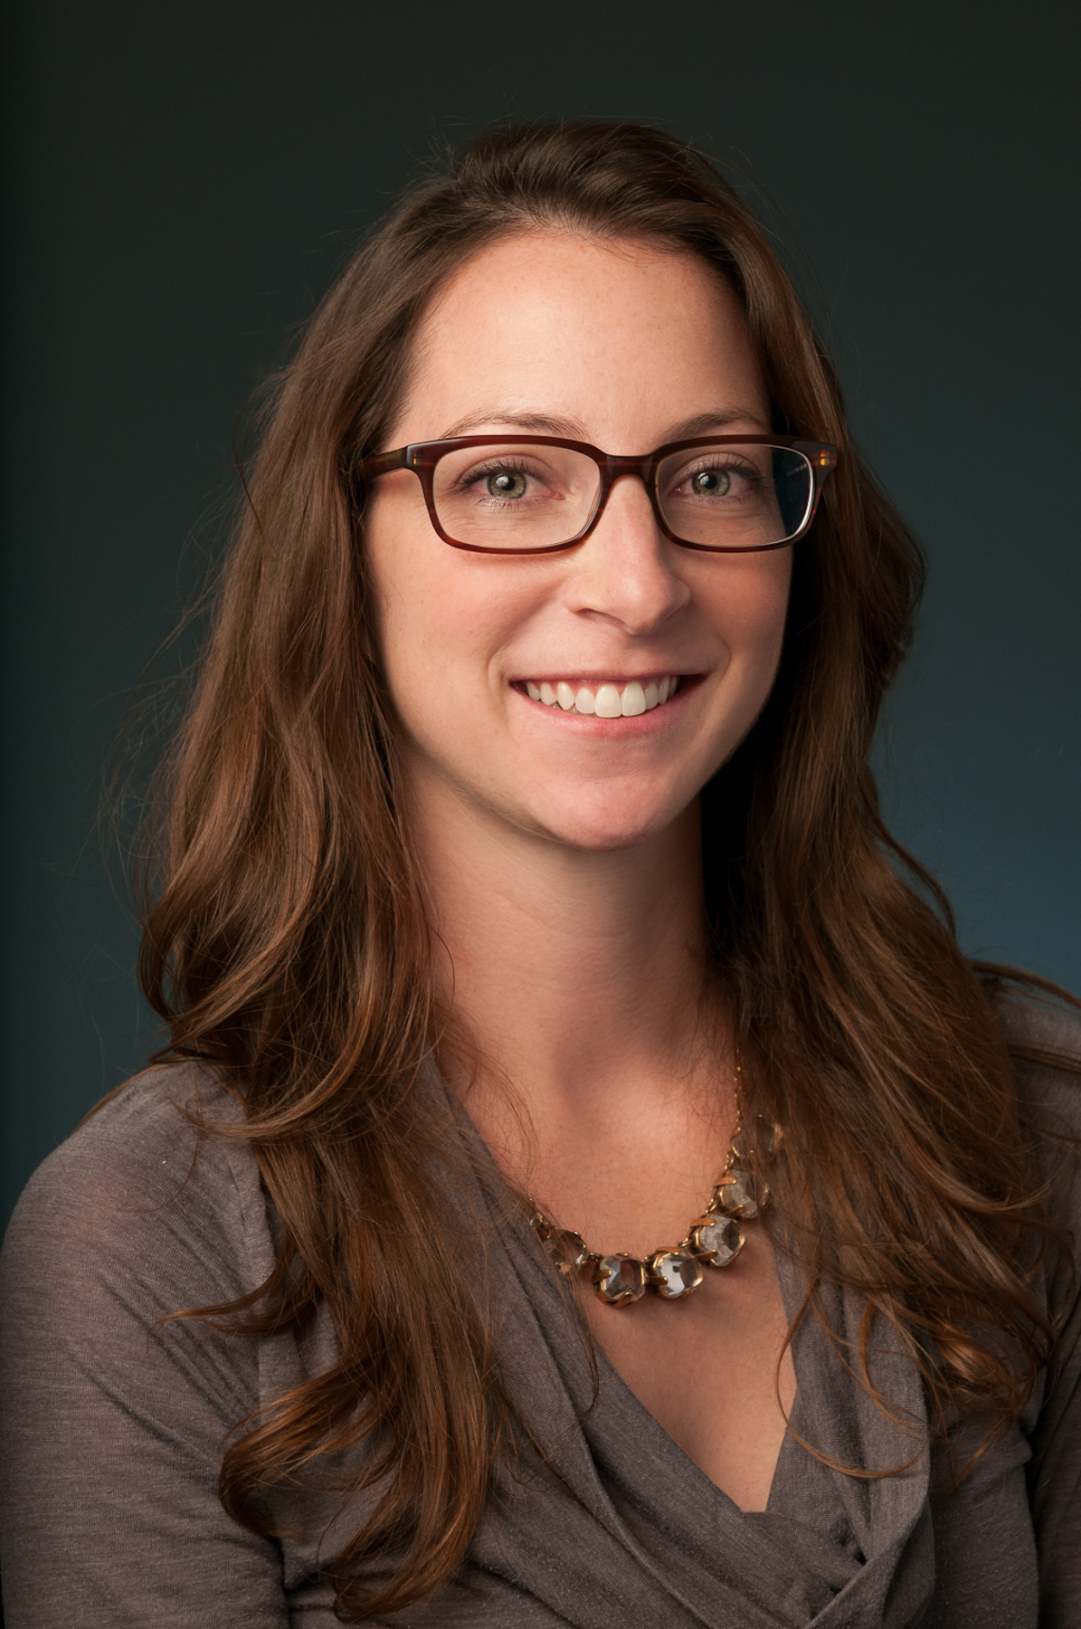
Welcome!
Purpose
  Help institutions and systems design robust advising systems for implementing math pathways at scale.
  Provide step-by-step guidance for developing a comprehensive advising plan.
Primary audience
  Advising coordinators
  Math pathways initiative leads
Jenna Cullinane, Ph.D.
Strategic Policy Lead
Higher Education

Slide 3
Webinar Agenda
Goals
Context
Planning process for advising
Tools to support planning
Examples from states and institutions

Slide 4
Goals
NMP Goal: Dramatically increase student success and completion in higher education. All students learn mathematics content that is meaningful to their academic and career goals and helps them develop as independent learners and critical thinkers.
Objective: Establish mathematics pathways as the normative practice for all students to complete a college-level mathematics course within one year of postsecondary education.

Slide 5
Context
Why is it important to focus in detail on advising?
The success of math pathways depends significantly on advising.
Advisors play a critical role in supporting student success and completion.
Advisors are the committed, expert ambassadors for students regarding the processes and offerings of the institution.
Students are often overwhelmed by choices and not aware of the implications of pathway choices.
Advisors work in an environment of large case loads, diverse student needs, constant institution redesign, and regular turnover.

Slide 6
Context
  “Academic advisors are the most important resource to help new students clarify their goals and select courses that lead toward those goals” (Bailey, Jaggars & Jenkins, 2015).

Slide 7
Planning Process for Advising
Engage
Engage advisors in planning for math pathways implementation.
Plan
Create an advising plan.
Develop
Develop materials to guide advisors and students.
Train
Advise
Prepare and train advising staff.
Improve
Advise and enroll students.
Evaluate progress and use data for continuous improvement.

Slide 8
Planning Process for Advising
Engage
Engage advisors in planning for math pathways implementation.

Slide 9
Engage Advisors in Planning
Engage
Discuss:
Identify priorities and issues of importance to advisors.
Questions and concerns about math pathways.
Notes:
Use this strategy to communicate alignment between the implementation of math pathways and the values and interests of advisors.
-discuss the role of the leadership team and provide direction on how to communicate with the leadership team

Slide 10
Engage Advisors in Planning
Engage
Lay the foundation:
Make the case for why math pathways are good for students.
  Data on student success
  Student and faculty testimonials
  Sample lessons
  Questions
What other benefits are there for the institution? For faculty? For advisors?
Notes:
Change is deeply personal. Success change aligns peoples values

Slide 11
Engage Advisors in Planning
Engage
Ask advisors to participate:
Tools for advisors
Training
Plan for communications with students
Work with leadership team to surface and troubleshoot questions and concerns.

Slide 12
Planning Process for Advising
Plan
Create an advising plan.

Slide 13
Create an Advising Plan
Plan
Planning requires collaboration from:
Advisors
Institutional researchers
Math faculty
Student success faculty and staff
Faculty in charge of other disciplines
Registrar

Slide 14
Create an Advising Plan
Plan
Plan components:
A specific advising goal
Programs of study best suited to the math pathways
Strategies for targeting and marketing to students
Materials needed for advising
Training needs for formal and informal advisors
Checkpoints for evaluating progress
Who is responsible
Timelines

Slide 15
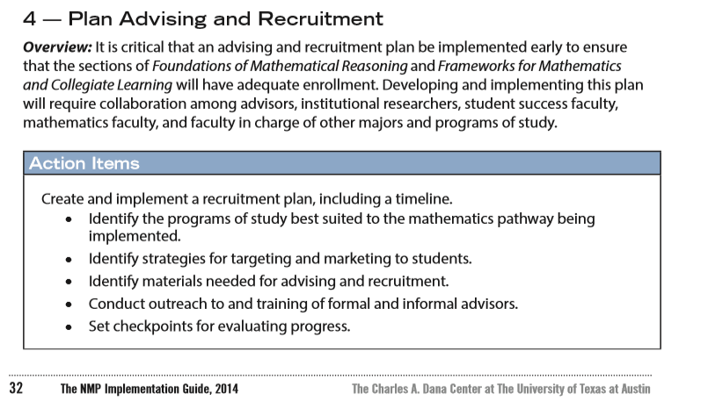
Resources
Plan
NMP Implementation Guide, p. 32–33
Available for download: http://www.utdanacenter.org/nmp/implementation_guide

Slide 16
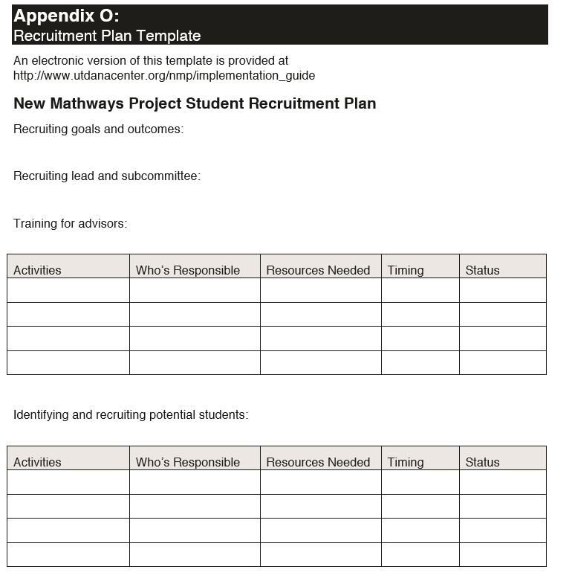
Resources
Plan
NMP Implementation Guide, p. 83
Electronic version of this template available: http://www.utdanacenter.org/nmp/implementation_guide

Slide 17
Create a Specific Advising Goal
Sample:
  “Pilot” vs. system redesign at scale
  Ninety percent of FTIC students are correctly advised into the appropriate meta-major and math pathway in the first semester of enrollment. Advising for FTIC students is mandatory. Students are advised to enroll in mathematics every subsequent semester until all math requirements for their program have been satisfied. Advisors will receive regular feedback about the accuracy of student enrollment based on their guidance and regular information about student success in new pathways. The institution will refine advising practices and policies until this goal is reached.
Notes:
- We do not do pilots. Pilots don’t’ scale
The evidence for math pathways is clear. Multiple sources
Experiment….1-2 sections. Maybe add 1 section a year. May take you 10 years to get to your scaling goals
Pilot is demanding for advisors. Have to operate two systems simultaneously. Determine who is eligible and who is not is subjective. Added layer of sorting.

Slide 18
Identify the Programs Best Suited to the
Math Pathways Being Implemented
Plan
Refer to your completed Program of Study Inventory Guide.
This inventory lists all programs of study and the math course requirements for each program.
You will need this information to create advising resources.

Slide 19
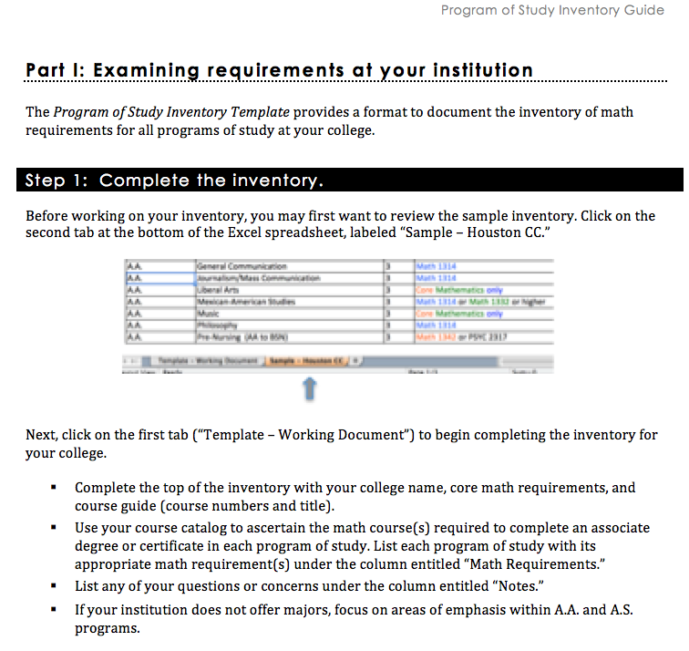
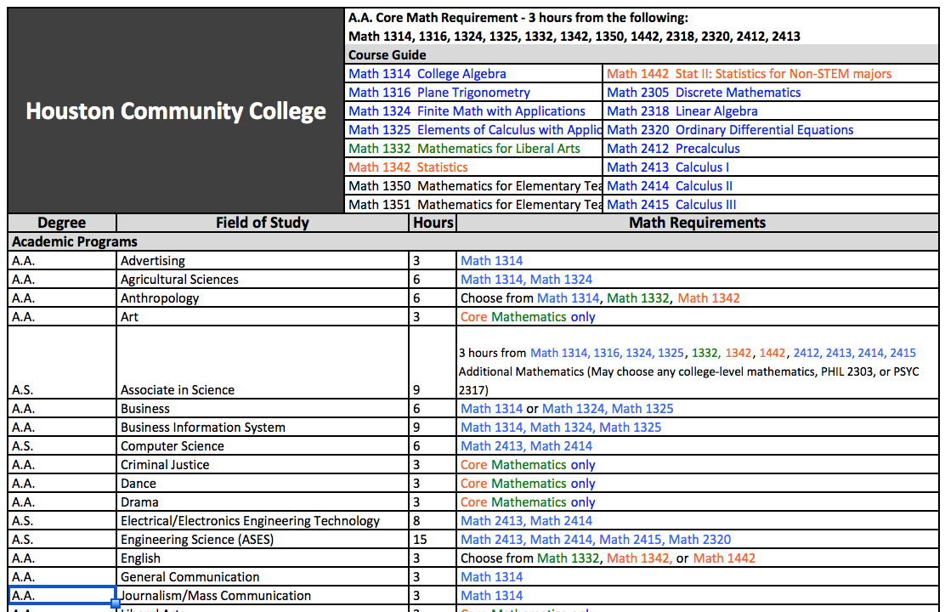
Resources
Plan
Program of Study Inventory Guide and Template
Available for download: http://www.utdanacenter.org/higher-education/new-mathways-project/the-new-mathways-project-in-texas/nmp-implementation-resources/nmp-institutional-scaling-toolkit/readiness-assessment/

Slide 20
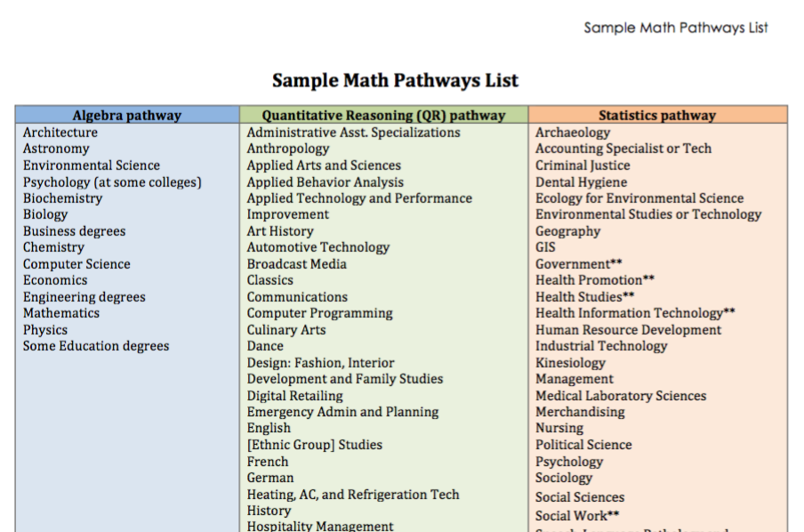
Resources
Plan
Sample Math Pathways List
Available for download: http://www.utdanacenter.org/higher-education/new-mathways-project/the-new-mathways-project-in-texas/nmp-implementation-resources/nmp-institutional-scaling-toolkit/readiness-assessment/

Slide 21
Create an Advising Plan
Plan
  Establish which math pathway will be the default for each program. Consider:
  What are the current default or de facto math courses for programs?
  What steps should be taken and who needs to be engaged to promote a particular math pathways as the default?
  What information will advisors need to feel comfortable using new math pathways as default courses?
  What is the smart default for undecided students?
Notes:
The Program of Study Inventory can be used to assign multiple math pathways as the default mathematics courses for each meta-major group.
The next step is to engage advisors to build support for establishing multiple math pathways as the default

Slide 22
Create an Advising Plan
Plan
  Work with the institutional research office to estimate the potential number of students to serve.
Data:
  Enrollment in programs of study, by preferred gateway math course
  Enrollment in current college-level courses
  Enrollment in current developmental courses
  Students who fail to enroll in subsequent courses in sequences
Notes:
Once your institution has used the Program of Study Inventory to identify which major/metamajors are best suited to the mathematics pathway being implemented, the next step is to identify a cohort of students to recruit
Bullet 1)
Think about groups of students to enroll rather than individuals
Target students in programs that accept a given pathway and work with faculty in this program to increase awareness and enrollment

Slide 23
Create an Advising Plan
Plan
Planning considerations for identifying the student population:
  What do you know about the developmental and college-level math student population?
  Who is responsible for advising students in different programs?
  From where do these students get advising information?
Notes:
Once your institution has used the Program of Study Inventory to identify which major/metamajors are best suited to the mathematics pathway being implemented, the next step is to identify a cohort of students to recruit
Bullet 1)
Think about groups of students to enroll rather than individuals
Target students in programs that accept a given pathway and work with faculty in this program to increase awareness and enrollment

Slide 24
Create an Advising Plan
Plan
Planning considerations for marketing and communications:
  Have you created a message based on the benefits of math mathways for populations your college serves?
  How will students learn about math pathways?
  Do all students meet with an advisor? If not, what resources support students to make their own decisions about math pathways?
  Do opportunities exist to gather information about students’ goals to trigger strategic outreach?
Notes:
How will your campus increase awareness among students of math pathways as an option? To develop a strategy, you may want to consider the following questions.

Slide 25
Create an Advising Plan
Plan
Planning considerations for training:
  What is the structure of advising at your institution?
  How will training and professional learning align with institutional structure (i.e., multi-campus, program-specific advising, campus experts)?
Formalize and disseminate plan.
Notes:
How will your campus increase awareness among students of math pathways as an option? To develop a strategy, you may want to consider the following questions.

Slide 26
Planning Process for Advising
Develop
Develop materials to guide advisors and students.

Slide 27
Develop Materials to Guide Advisors and Students
Develop
Develop a model for decision-making and discussion to help advisors determine the appropriate math pathways for students.
Verify that the information is accurate and complete.
Revise tools to enhance usability and clarity.
Develop student-facing resources.
Test materials under realistic conditions with advisors and students.

Slide 28
Resources
Develop
Creating Effective Advising Tools
Sample decision tree
Advisor-student conversation guide
Sample student resources
Available for download: http://www.utdanacenter.org/higher-education/new-mathways-project/the-new-mathways-project-in-texas/nmp-implementation-resources/nmp-institutional-scaling-toolkit/readiness-assessment/

Slide 29
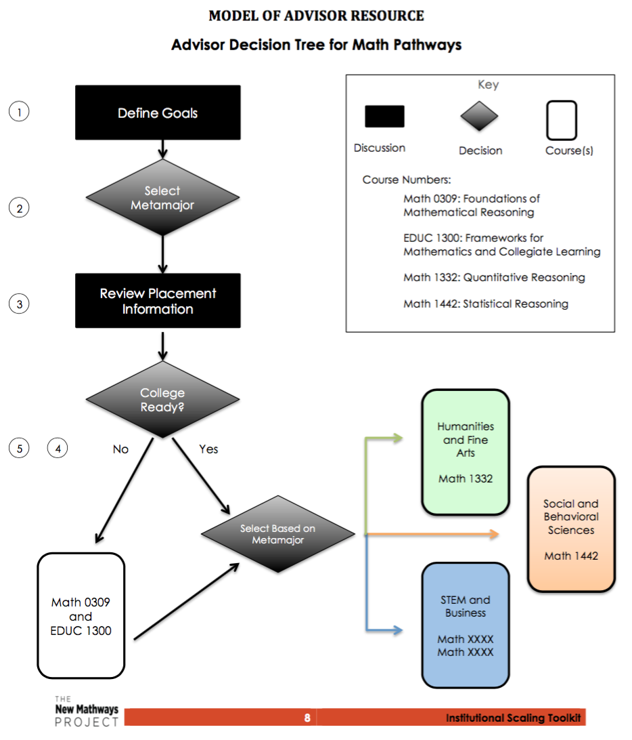
Resources
Develop
Creating Effective Advising Tools
Decision tree
Define goals.
Select a meta-major.
Review placement information.
Determine college readiness.
Select courses.
Available for download: http://www.utdanacenter.org/higher-education/new-mathways-project/the-new-mathways-project-in-texas/nmp-implementation-resources/nmp-institutional-scaling-toolkit/readiness-assessment/

Slide 30
Resources
Develop
Creating Effective Advising Tools
Tips about improving efficacy of advising materials:
Visually display information so it is clear and engaging.
Design resources to meet the needs of those who would most benefit.
Tailor resources to meet the different needs of advisors and students.
Available for download: http://www.utdanacenter.org/higher-education/new-mathways-project/the-new-mathways-project-in-texas/nmp-implementation-resources/nmp-institutional-scaling-toolkit/readiness-assessment/
Notes:
Design resources to meet the needs of those who would benefit from them the most
the advisor with the least experience or a very large caseload
the student who knows little about college

Slide 31
Resources
Develop
Example of student-friendly and advisor-friendly language:
Math 0309: Foundations of Mathematical Reasoning
Give math another chance! In this class, you will learn about the math involved in things like credit card debt or how much material you need for your patio. This course covers math concepts that you will use in your everyday life and that are relevant to your career. We will use websites, advertisements, and tax documents so that these math concepts are meaningful to you. You will have a ton of resources to draw upon and when you finish this course, you will be well prepared for your college-level mathematics course.

Slide 32
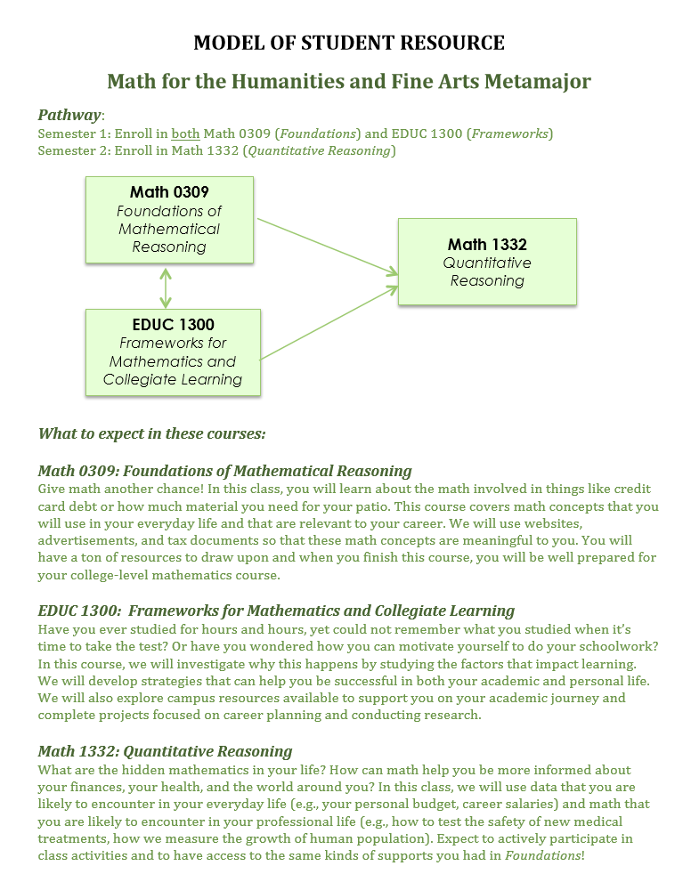
Resources
Develop
Example of student resource:
Notes:
What information is most important to students?
How should a student facing decision tree differ from an advisor facing decision tree?
What differences do you notice?
How might your institution tailor resources to meet the needs of different audiences?

Slide 33
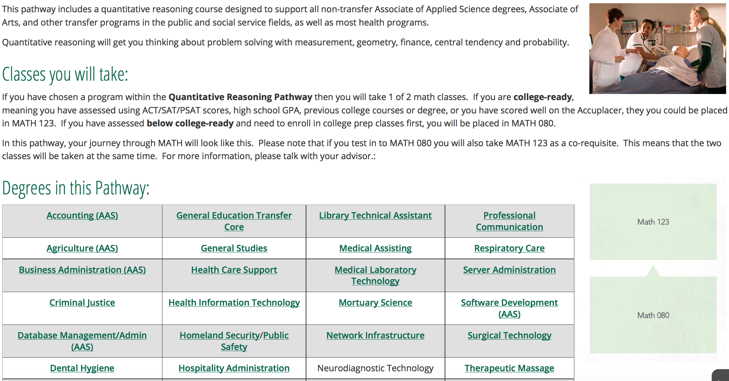
Resources
Develop
Example of student resource: Ivy Tech Community College
Link: https://www.ivytech.edu/math-pathways/3208.html

Slide 34
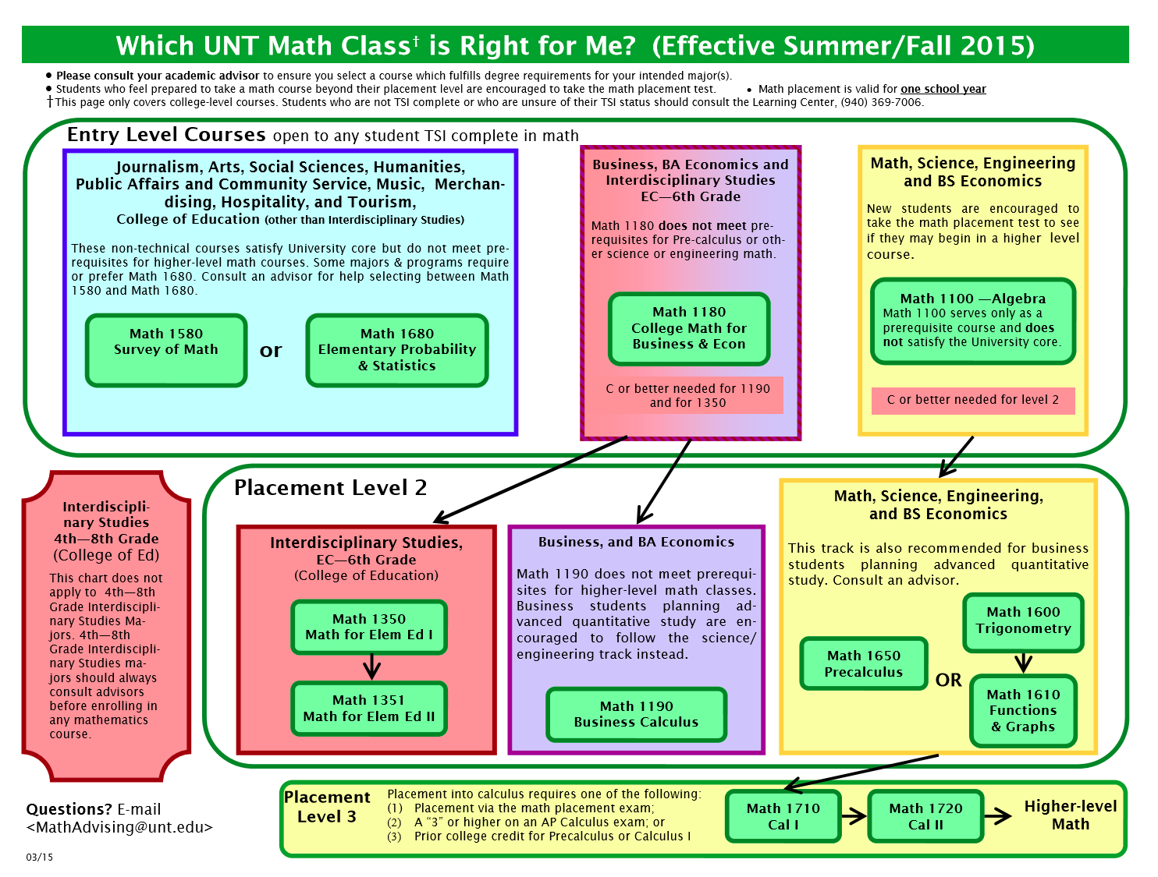
Resources
Develop
Example of resource for advisors and students clustered by majors: University of North Texas
Notes:
Each meta-major may then be aligned to a statistics or quantitative reasoning math pathways as illustrated here by the University of North Texas

Slide 35
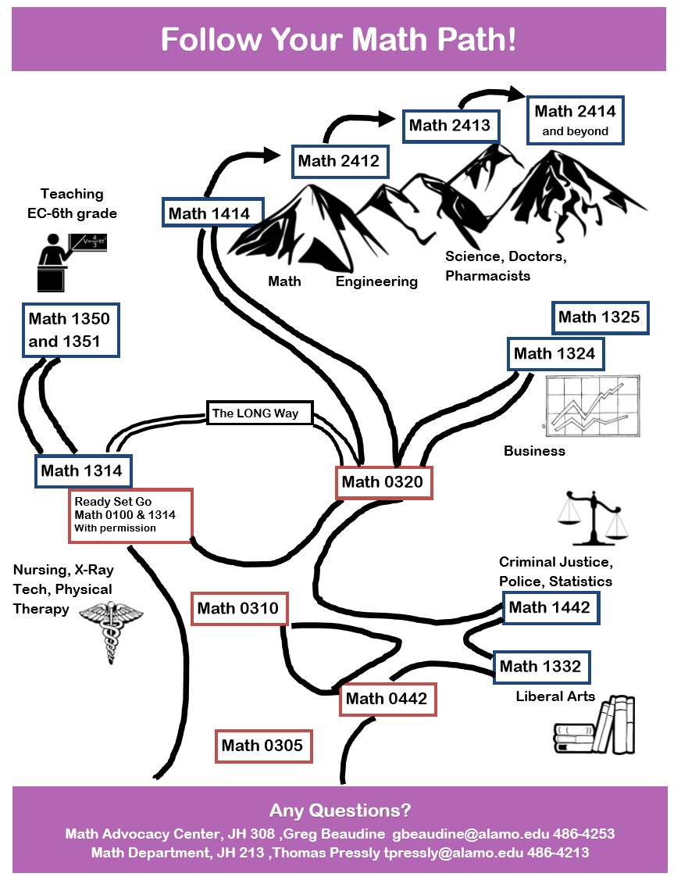
Resources
Develop
Example of student resource: Northwest Vista College
Notes:
What information is most important to students?
How should a student facing decision tree differ from an advisor facing decision tree?
What differences do you notice?
How might your institution tailor resources to meet the needs of different audiences?

Slide 36


Resources
Develop
Examples of broad awareness campaigns: Ivy Tech Community College and Houston Community College
Link: https://www.ivytech.edu/math-pathways/ and http://www.hccs.edu/district/students/hcc-new-mathways/

Slide 37
Planning Process for Advising
Train
Prepare and train (advising) staff.

Slide 38
Prepare and Train (Advising) Staff
Train
  Identify training lead.
  Require math pathways training for all advisors.
  Train formal and informal advisors using real-world scenarios created by advisors.
    Role play
    Practice using new language of pathways
    Feedback
    Shadow

Slide 39
Prepare and Train (Advising) Staff
Train
  Student Scenario: Martha Garcia
Martha arrives at freshman orientation. She has prior college coursework from Midland College. She does not have a transcript with her and says that her prior coursework wouldn’t transfer anyway. On a whim, she takes the placement test for reading, writing, and math, which equal:
  Reading: 331, ABE of 3; Writing: 341 multiple-choice and 2 essay, ABE of 3; Math: 324, ABE of 2
After a few minutes of discussion, Martha is interested in becoming a journalist and would like to study at Texas Tech University after finishing her degree with us.
Using the Academic Advisor Decision Tree, how should we guide Martha toward the appropriate developmental and mathematics coursework – both serving her current and future academic needs?

Slide 40
Prepare and Train (Advising) Staff
Train
  Provide information about math pathways during advisor orientation, weekly information sessions, bi-weekly advising, and monthly check-in meetings.
  Require a math pathways professional development session for faculty, deans, and department chairs.
  Collaborate with academic support programs and meet regularly to provide information on math pathways advising efforts.

Slide 41
Planning Process for Advising
Advise
Advise and enroll students.

Slide 42
Advise and Enroll Students
Advise
  Provide brief student–parent–faculty engagement session at student orientation about math pathways.
  Provide information about math pathways during individual advising sessions.
  Conduct group advising sessions to register students for math pathways courses by program.
  Embed math pathways information in online advising resources and registration processes.
  Provide explicit support for students to enroll in second semester of math.

Slide 43
Planning Process for Advising
Improve
Evaluate progress and use data for continuous improvement.

Slide 44
Evaluate Progress and Use Data for
Continuous Improvement
Improve
  Use advising, enrollment, and pathway completion data to assess progress toward your goals.
    Marketing and communication
    Advising accuracy (first course, pathway completion)
    Scale
    Student performance
  Assess advising successes and challenges to achieve your goals.
  Continue to engage advisors, provide ongoing training, and revise tools as necessary.

Slide 45
Planning Process for Advising
Engage
Engage advisors in planning for math pathways implementation.
Plan
Create an advising plan.
Develop
Develop materials to guide advisors and students.
Train
Advise
Prepare and train advising staff.
Improve
Advise and enroll students.
Evaluate progress and use data for continuous improvement.

Slide 46
Contact Information
General information about the Dana Center: www.utdanacenter.org
Higher Education work:
www.utdanacenter.org/higher-education/
To receive monthly updates about the NMP, contact us at: mathways@austin.utexas.edu

Slide 47

About the Dana Center
The Charles A. Dana Center at The University of Texas at Austin works with our nation’s education systems to ensure that every student leaves school prepared for success in postsecondary education and the contemporary workplace.
Our work, based on research and two decades of experience, focuses on K–16 mathematics and science education with an emphasis on strategies for improving student engagement, motivation, persistence, and achievement.
We develop innovative curricula, tools, protocols, and instructional supports and deliver powerful instructional and leadership development.

